Slide 1

Boost Your Team’s Bus Factor:
Creating Docs That Work
By Keith Wedinger, Principal Consultant at Improving

Slide 2

Before we get started
No need to write down or take pics of slide deck content
Presentation link: https://shorturl.at/k3X68
Please stop me at any time to ask questions

Slide 3
Agenda
Introduction
Bus Factor
Why do we need this
Story Time
What makes documentation effective (and not)
What needs to be covered
Who writes and maintains this
How do you write it
Questions

Slide 4
Thank you to the Sponsors!
Fifth Third Bank
Eliassen Group
Western & Southern
Afidence
Ingage
Encore Talent
MAX Technical Training
CGI
Agility Partners
Cincinnati Zoo
American Sign Museum
Breadkrumb
Woodburn Games
TQL

Slide 5

WHO-DEY!

Slide 6
Introduction
36+ year career (I'm getting old)
Several development projects for multiple companies
IBM, Lexmark, Diebold, Limited Brands, Sterling Commerce, IBM (again), Leading EDJE, Crown Equipment Corp, Wendy's, Improving, Ohio State, Abercrombie & Fitch, Root Insurance, Sherwin-Williams, AWS, Lark Health
Worked with several teams with very effective documentation 😃
Worked with several teams where there was little to no documentation (and wrote docs for them) 😢
Who are you?
Notes:
Developed everything from x86 assembler in firmware to control a typewriter to developing Windows GUI applications for Windows 3.1, Windows 95 and Windows NT to developing full stack applications using a variety of databases, tech stacks and frontend clients. It really is amazing to think back and see how far technology has advanced.
Who are you? Developers? Project managers/scrum masters? Engineering managers?
Quick survey time:
Who thinks they have effective well maintained up to date documentation?
Who thinks they have docs but they could be improved?
Who thinks they have little to no docs?

Slide 7
About Improving
Modern digital services company and trusted AI expert for Fortune 500 and Global 1000 enterprises
Software consulting, development, near sourcing, training
Dedicated to building and advancing a great work culture that fosters trust and exemplifies teamwork, excellence, and fun
Core values
Excellence
Involvement
Dedication
Offices across the country including Ohio. Also in Mexico, in Argentina and in India
Notes:
What is your company make up?
Large (greater than 1000 employees)
Medium (between 250 and 1000)
Small (less than 250)
Full time employees?
Consultants?

Slide 8
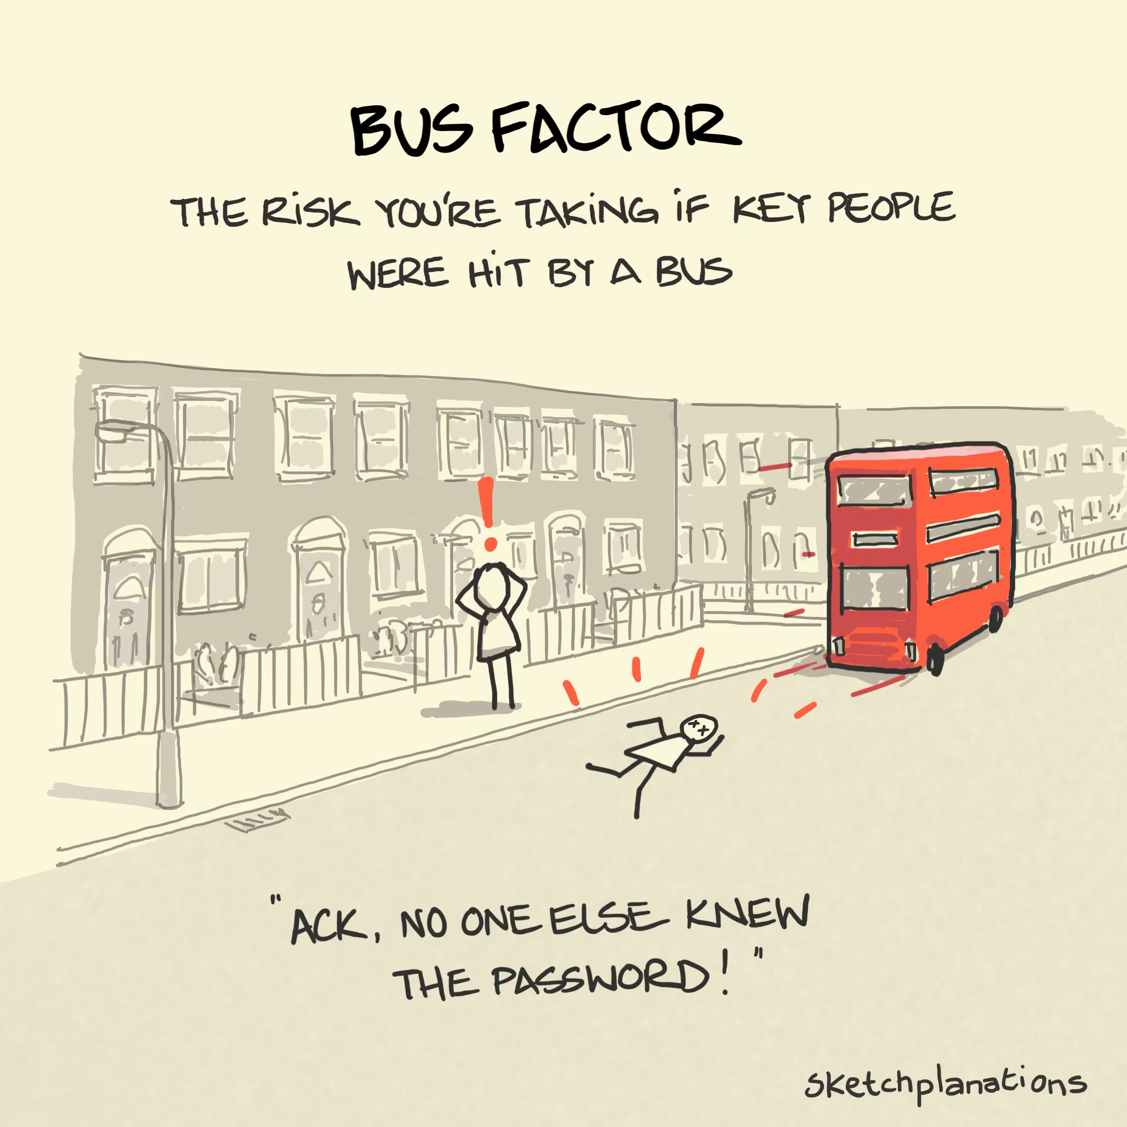
Bus Factor
Measures how many team members could become unexpectedly unavailable (e.g., hit by a bus) before a project is critically impacted
A high bus factor means knowledge and responsibilities are well-distributed across the team
A low bus factor signals dependency on a few individuals, increasing project risk
Notes:
- My daughter asked what is a bus factor and I explained it to her as follows: Imagine you have a single person at your hospital who knows how to do this particular procedure. And that procedure is not documented anywhere so you all depend upon that person to get that procedure done. Now, imagine if that person got hit by a bus. Knowledge about the procedure is now gone.
- Who here thinks their team is at risk of having a key team member being “hit by a bus”?

Slide 9
Why do we need this?
2024 Stack Overflow Developer Survey
Knowledge silos where one individual or team has information that's not shared or distributed with other individuals or teams is a frequent problem
53% agree or strongly agree that waiting on answers disrupts their workflow
61% of all respondents spend more than 30 minutes a day searching for information
Docs that work WILL save significant time! ⏱

Slide 10
Story Time
Onboarding with a new organization
I did something useful, and I need to do it again, but I don’t remember how 🤦‍♂️
Key contributor with siloed knowhow goes on vacation
Notes:
At a previous client of mine, on my first day, I needed to be onboarded. This client had no onboarding documentation. A fulltime employee there was my guide for getting some basic things done like getting my security badge and make sure I had access to a few things. Later that day, I was told how to clone the GitHub repository at which point, it was my responsibility to “figure things out”. I spent quite a bit of time digging into things on my own, figuring out how to get the correct dev tools installed, interrupting other co-workers with lots of questions. Quite a frustrating experience to say the least.
At another client, I needed to create a set of Azure resources to capture and graph events. After doing a quite a bit of research online, I was finally able to complete the creation of everything and getting everything working. Soon after, I got sidetracked and moved onto working on something else, forgetting to take the time to write down how to do what I just did. Sure enough, a few weeks later, I needed to do the same thing. I combed through OneNote hoping to find my HOWTO notes (surely, I took the time to document how to do this). Nope. So, I had to start over.
At another client, I was on a team responsible for adding features to and fixing bugs on the company’s website. This client used their own private, internally managed dependency repository. Basically an internal subset of npmjs. As part of a React upgrade I was working on, I needed to add several new dependencies to this private repository, There was one person on the team who knew how to do this and that person was out of the office on vacation. And the process on how to do this was not documented. We had to wait several days before we could proceed.

Slide 11
What makes documentation effective (and not)
Accuracy
Be specific and eliminate repetition (be DRY)
Ambiguity is BAD 🤷‍♂️
Repetition can be worse (no “single source of truth”) 😳
Meaningful titles with prefixes
Correct grammar and spelling
Clear and concise easily readable verbiage (AI can help)
Search that works
Templates for common document formats
Makes starting a new document much easier by setting content expectations
Especially useful for technical design documents
Notes:
Accuracy: Having inaccurate or incomplete docs, especially for HOWTO docs, can be very frustrating. Think “why isn’t this working”?
Prefixes can be things like EDD for engineering design document or HOWTO for a howto or perhaps a story number for a feature
- Show documentation tree in confluence
Having searches return an endless stream of what look like irrelevant hits is not helpful and frustrating.
AI example:
Please correct and refine the following from my engineering design document:
When the GHA is triggered, when the appropriate build is triggered and is ✅ inside GitHub, the app submission GitHub action will be triggered. eas build --auto-submit provides a link to the submission details page where the progress of the submission will be tracked. This page can also be viewed any time on the EAS submissions dashboard for the new app.
Templates that can be easily copied / pasted to create new docs are a great way to get started on writing new docs.
- Show search for template and resultant EDD template

Slide 12
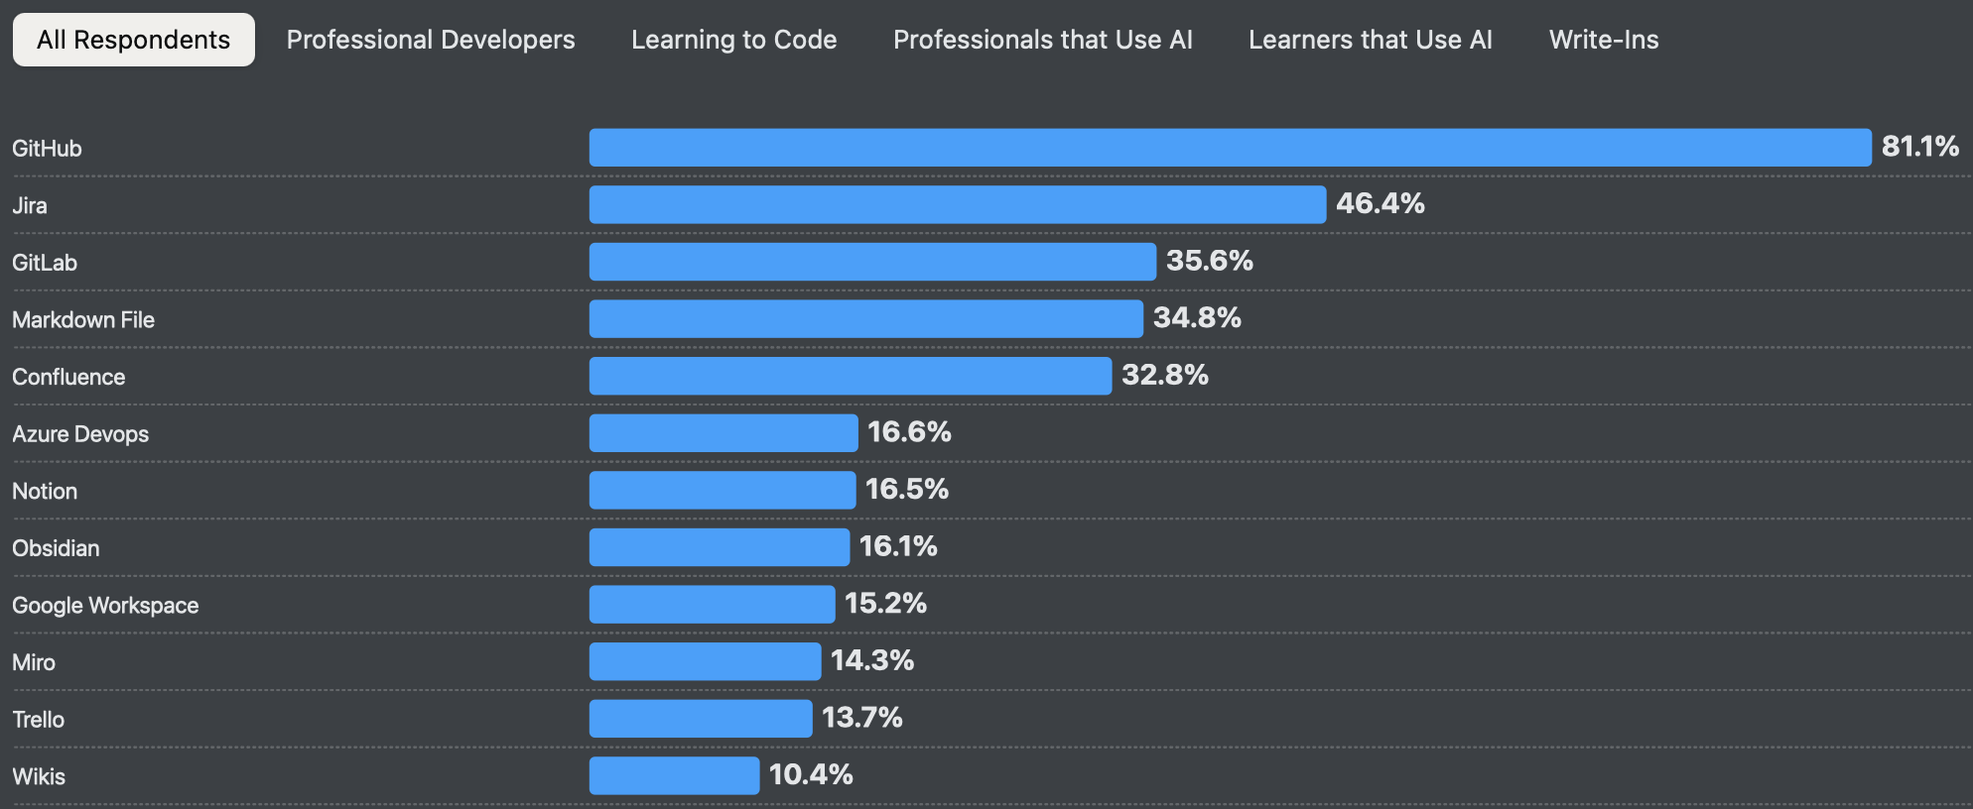
What makes documentation effective (and not)
Choose the right tool
Collaboration & Accessibility
Integration with Development Tools
Integration with AI
Content Types & Formatting
Hosting & Security
Versioning & History
Usability & Adoption
Cost & Licensing
Notes:
Collaboration & Accessibility
Real-time collaboration: Can multiple team members edit simultaneously?
Permissions & access control: Can you manage who can view, edit, or comment?
Searchability: Is it easy to find documents, code snippets, or diagrams?
Integration with Development Tools
Version control integration: Does it integrate with GitHub, GitLab, Bitbucket, etc.?
IDE plugins: Are there extensions for VS Code, IntelliJ, etc.?
Integration with AI
Rovo chat inside Confluence
Content Types & Formatting
Markdown support: Widely used in engineering teams for its simplicity.
Code highlighting: Syntax highlighting for multiple languages.
Diagrams & visuals: Support for imbedded diagrams, models and images.
Hosting & Security
Cloud vs. self-hosted: Do you need full control (e.g., for compliance) or prefer managed hosting?
Authentication: Does it support SSO?
Data encryption & backups: Are your documents secure and recoverable?
Versioning & History
Document versioning: Can you track changes and revert to previous versions?
Change notifications: Are team members notified of updates?
Usability & Adoption
Ease of use: Is the UI intuitive for both technical and non-technical users?
Templates & structure: Can you create reusable templates or enforce documentation standards?
Mobile support: Is it usable on tablets or phones?
Cost & Licensing
Pricing model: Per user, per project, or flat rate?

Slide 13
What needs to be covered
Onboarding(!!)
Extremely important, especially in hybrid/remote work environments
Aim for self service
Contact info and responsibilities for all team members
Include project owner/sponsor, PMs, Scrum Masters, BAs, Developers, QA, IT support
Include email, phone numbers, work locations
Getting access to systems and data
Install and set up local development environment
Required training
Notes:
If you do nothing else, document your onboarding process. Effective onboarding docs that work will leave a great first impression on new team members.
Show onboarding
Under Install and set up local development environment
What OS and version needs to be installed?
What SDKs are required?
What editors / IDEs and versions are required/recommended?
How is the IDE configured to conform to project development standards?
What database and version is required?
Web projects: What browsers and versions are supported?
Cloud projects: Vendor, account information
Mobile projects: What devices are supported and where do I get them?
What version control system is being used?
What build tool software and version is needed?
Ant/NAnt, Maven, Gradle, MSBuild, Grunt, Gulp, internally developed/proprietary?
What dependency management server is used?
What continuous integration pipeline is being used?
Project directory structure
Describe what can be found and where
Very important if the project deviates from commonly followed patterns
Very important if structure is "very large"

Slide 14
What needs to be covered
HOWTO’s
Project requirements
Architecture and design docs
Company handbook
Engineering position levels with expectations for each
Hiring and interviews
Notes:
HOWTO’s
If you have done something useful or novel, write it down and share it. Chances are pretty good that someone else on your team will need to do the same thing at some point.
Show 37signals company handbook. Inside GitHub, version controlled

Slide 15
What needs to be covered
Standards and processes
How is the project pulled from source control, built, tested, installed/deployed and executed?
RED ALERT 🚨: If this is not relatively straightforward, there may be something amiss in the project
What standards and/or guidelines are followed when developing, testing, reviewing, merging and deploying changes?
Notes:
Show ticket for README and PR review template

Slide 16
Who writes and maintains this
Everyone! Entire team owns it
SMEs (subject matter experts) usually write initial versions
Enlist help from others to write it and to review it
Do not put this off until later!!
Do not ignore it once it's written!!
TEST IT!
Notes:
Reviews by other teams members are very useful. After looking at a doc for a long time, we as writers can get tunnel vision, overlooking things. Getting a fresh set of eyes on your doc can uncover things we are missing.
There is no designated doc writer.
Putting things off will create additional technical debt
TEST IT! - Step by step instructions and HOWTO’s should be verified to ensure they do what they say they will do.

Slide 17
How do you write it
Document things for yourself
Start with great tools and templates
Know and target your audience
KISS - Keep it simple and straightforward
DRY – Don't repeat yourself
Pictures are worth a 1000 words
Organize into categories
Use AI to refine (*)
Delete anything that is obsolete or is no longer relevant
Create stories or tasks in each sprint to write and update docs
Treat it as a project deliverable
Notes:
Know and target your audience. Having a prerequisites section can be very helping at setting a baseline, especially if it contains links to find out more about these prereqs.
KISS – Don’t over-engineer. If you can state something clearly in 10 words, don’t use 25. Less oftentimes is more.
DRY – Single source of truth
Pictures:
- Screenshots and screencasts are tremendously useful when doing onboarding or HOWTO docs.
Use AI to refine:
AI cannot write your docs from scratch but it can help refine your docs when given proper context and prompting.
Prompts with context and the information you wish to convey allow for very effective refinement. Write a first draft of what you want to document. Then, ask AI to refine that paragraph as follows: “I am currently writing an onboarding document in Confluence. Please refine the following first draft”.
Show problem statement example
Be very mindful of your company’s policies when using AI.
Delete dead docs
- Avoid “we might need this later”. If version controlled, it can be brought back. Don’t be a doc hoarder. It is OK to clean out the closet and get ride of stuff we no longer use or need.

Slide 18
Questions
keith.wedinger@improving.com
X: @jkwuc89
LinkedIn: https://www.linkedin.com/in/kwedinger
GitHub: https://github.com/jkwuc89
This presentation: https://shorturl.at/k3X68

